Slide 1

MEN AS ALLIES – A CONVERSATION
Why Allyship Is Important As a Leader
And In Your Career
Monday, April 25, 2022
5:00 p.m. (Eastern)

Slide 2
AGENDA
Welcome and Introductions
Moderated Discussion with Questions Invited:
  Kelvin Chen: Vice President, Senior Associate General Counsel, Capital One.
  Dan Fichtler: Associate Vice President of Housing Finance Policy, Mortgage Bankers Association.
  Ben Wilson: Chairman (Retired), Beveridge & Diamond, P.C.
  Charles Yi: Senior Advisor for Legal Affairs and Policy, Federal Housing Finance Agency.
  Michael Briggs (Moderator): General Counsel, Mortgage Bankers Association.
Closing Remarks
Upcoming Events

Slide 3
NORMS FOR TODAY’S DISCUSSION
This is a safe space for a thought-provoking conversation.
We’re here to listen and learn, and to be inspired to action.
We encourage honest and direct participation.
Uncomfortable or awkward questions are invited.

Slide 4
OUR PANELISTS

Slide 5
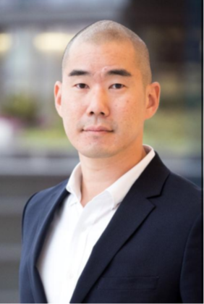
Kelvin Chen
Kelvin Chen leads the Capital One Legal Department's Regulatory
Advocacy; Corporate Regulatory Advisory; and Risk & Audit Counsel teams.
Prior to joining Capital One in late 2019, Kelvin created and led the Federal Reserve Board’s Innovation Policy team in the Division of Supervision & Regulation. His team helped the Board understand and navigate policy issues arising from technological change.
Before joining the Board, Kelvin served as the Consumer Financial Protection Bureau’s Program Manager for Emerging Payments. There, he led the agency’s policy response to various payment innovations, such as virtual currencies. In prior roles, Kelvin led the Bureau’s study of mandatory arbitration provisions; advised agency principals at the Federal Trade Commission on policy and enforcement matters; and was a litigator in the New York offices of Morrison & Foerster LLP, and Cadwalader, Wickersham & Taft LLP.
Kelvin studied Systems Engineering and Mathematics at the University of Pennsylvania (’00); attended New York University School of Law (’04); and is affiliated with the Princeton Center for Information Technology Policy and the Digital Dollar Project.

Slide 6
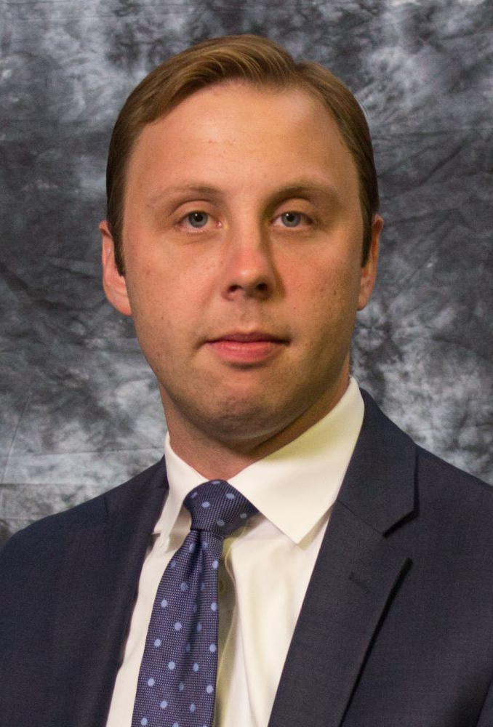
Dan Fichtler
Dan Fichtler is Associate Vice President of Housing Finance Policy at the Mortgage Bankers Association.
In this role, he is responsible for developing MBA’s policy work related to loan production issues, including the government housing programs operated by FHA, VA, and USDA, as well as secondary and capital markets issues, including agency and non-agency securities markets and the activities of FHFA, Fannie Mae and Freddie Mac, Ginnie Mae, and the Federal Home Loan Banks. He also serves as the lead staff representative for MBA’s Residential Board of Governors.
Prior to joining MBA, Dan was a policy advisor at the U.S. Department of the Treasury, where he served on the staff of the Financial Stability Oversight Council. He has also served as an advisor to the majority staff of the Senate Banking Committee, during which time he helped draft the Johnson-Crapo housing finance reform legislation.

Slide 7
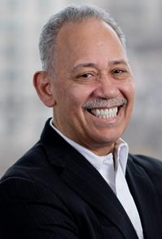
Ben Wilson
Benjamin F. Wilson is the former Chairman of Beveridge & Diamond, P.C., a top-ranked law firm focused on environmental and natural resource law and litigation. He represented major corporations, developers, and municipalities in complex litigation matters involving Clean Water Act enforcement, wetlands development, Superfund and environmental justice matters. He served as the Deputy Monitor for Emissions & Environmental in the Volkswagen AG emissions proceedings and served as the Court-Appointed Monitor for the Duke Energy coal ash spill remediation project.
A tireless advocate for diversity and inclusion in the legal profession, in 2022, the Council for Court Excellence will present Mr. Wilson with the Justice Potter Stewart Award, and in 2021 The American Lawyer announced it would present Mr. Wilson with its Lifetime Achievement Award. Also in 2021 Lawyers of Color named him among the 10 Most Influential Black Lawyers of the Decade and he was named to Lawdragon's inaugural list of the top 500 Energy & Environment attorneys nationwide. In 2020, Mr. Wilson received The Honorable Annice M. Wagner Pioneer Award from the District of Columbia Bar, was elected to the American Law Institute, was inducted into the Washington Bar Association’s Hall of Fame, was awarded the Cora T. Walker Award from the National Bar Association Commercial Law Section, and was featured in the National Law Journal’s cover story "The Vanguard and the Vision." In 2019, he received the National Bar Association’s Presidential Award, and in 2018, NAWL’s Lead by Example Award and the UNCF’s MASKED Award. He founded and leads the African American General Counsel and Managing Partner Networks and Diverse Partners Network.
Mr. Wilson graduated from Dartmouth College and from Harvard Law School. He has served as Chairman of the Environmental Law Institute since 2016. Mr. Wilson serves on the Judicial Nomination Commission for the District of Columbia and the D.C. Bar Foundation Board, Board of Directors of the Northwestern Mutual Life Insurance Company, of APCO Worldwide, and of PG&E Corporation. He previously served as a member of the Board of Trustees of Dartmouth College and the Board of Governors of the District of Columbia Bar. Mr. Wilson is also an Adjunct Professor in Environmental Law at the Howard University School of Law.

Slide 8
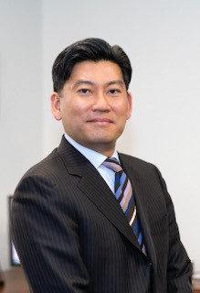
Charles Yi
For nearly 20 years, Charles Yi has practiced law and provided counsel in the private and public sectors on a wide range of regulatory, legislative, and financial services issues. He currently serves as the Senior Advisor for Legal Affairs and Policy at the Federal Housing Finance Agency. From 2015 to 2019, Yi served as the General Counsel at the Federal Deposit Insurance Corporation.
He has provided counsel to lawmakers on the Senate Banking Committee as the Staff Director and Chief Counsel, and previously served on the staff of the House Financial Services Committee. Yi was also Deputy Assistant Secretary for Banking and Finance at the U.S. Treasury Department where he assisted in the implementation of provisions under the Dodd-Frank Act. Before practicing law, he served as an Armored Cavalry officer in the U.S. Army and was deployed to Bosnia as part of a NATO peacekeeping mission. Yi is a graduate of Columbia Law School and also holds degrees from Princeton University, Bowie State University, and the University of California, Berkeley.

Slide 9
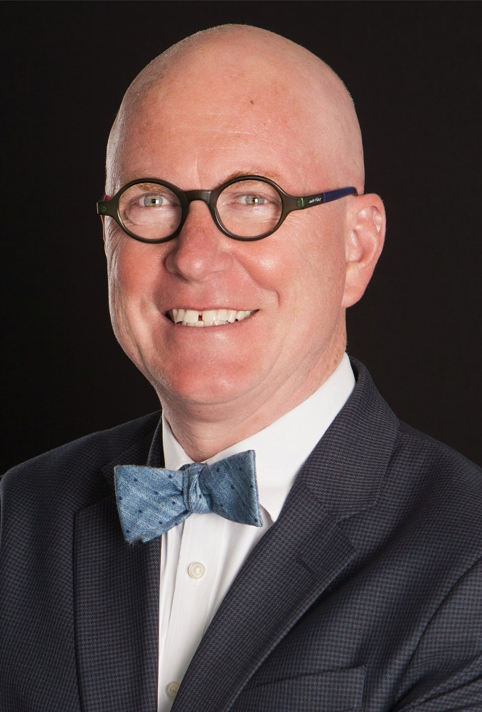
Michael Briggs
Michael Briggs is General Counsel and Senior Vice President for Human Resources at the Mortgage Bankers Association (MBA), where he oversees the association's internal legal affairs, compliance, and human resources operations. He also oversees the MBA Opens Doors Foundation, MBA's 501(c)(3) foundation that provides mortgage and rental payment assistance to families with critically ill or injured children.
Before joining the MBA, Briggs spent 12 years in several leadership roles in the FDIC Legal Division. He also was in private practice with Gordon Feinblatt LLC, a Baltimore firm where he represented a variety of financial services clients. Briggs previously served as Chief Legal Officer of America's Community Bankers. Earlier in his career, he served as Assistant General Counsel for Regulatory Affairs at Bank of America Corporation.
Briggs currently serves as vice-chair of the Diversity, Equity, and Inclusion Task Force of the ABA's Consumer Financial Services Committee. In addition, he is a member of the LGBTQ Bar Association of Maryland, Women in Housing and Finance, and ALLRISE DC. He earned his LL.M. degree in financial services law from Boston University School of Law. Briggs also holds a J.D. cum laude from Drake University Law School and a bachelor's degree from the College of Journalism and Communications at the University of Florida.

Slide 10
ABOUT ALLRISE DC

Slide 11
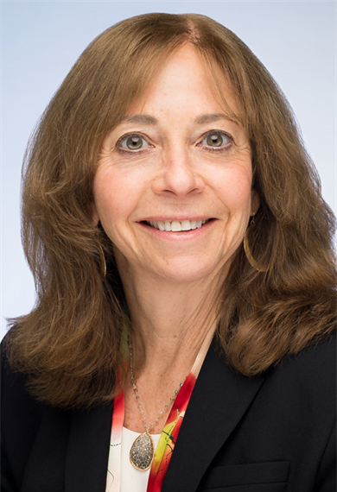
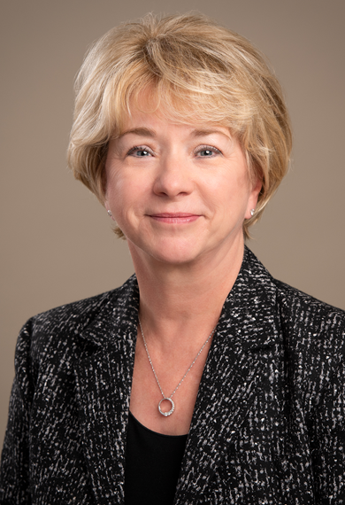
ALLRISE DC
ALLRISE DC is a Washington, D.C.-based organization working to lift women's careers in financial services through mentoring, networking, and education. ALLRISE DC was founded by Amy Friend, Senior Advisor to FS Vector and former Chief Counsel of the Office of the Comptroller of the Currency, and Sally Miller, former CEO of the Institute for International Bankers.
Both Sally and Amy remain actively involved in financial services, including serving on boards of directors. https://www.ALLRISEDC.org

Slide 12
THANK YOU

